Slide 1
Chapter 3: the image, its mathematical and physical background
Image processing, analysis and machine vision
Dong Sun Park
Monday, May 11, 2020

Slide 2
Contents
Overview
Linear integral transforms
Images as stochastic processes
Image formation physics

Slide 3

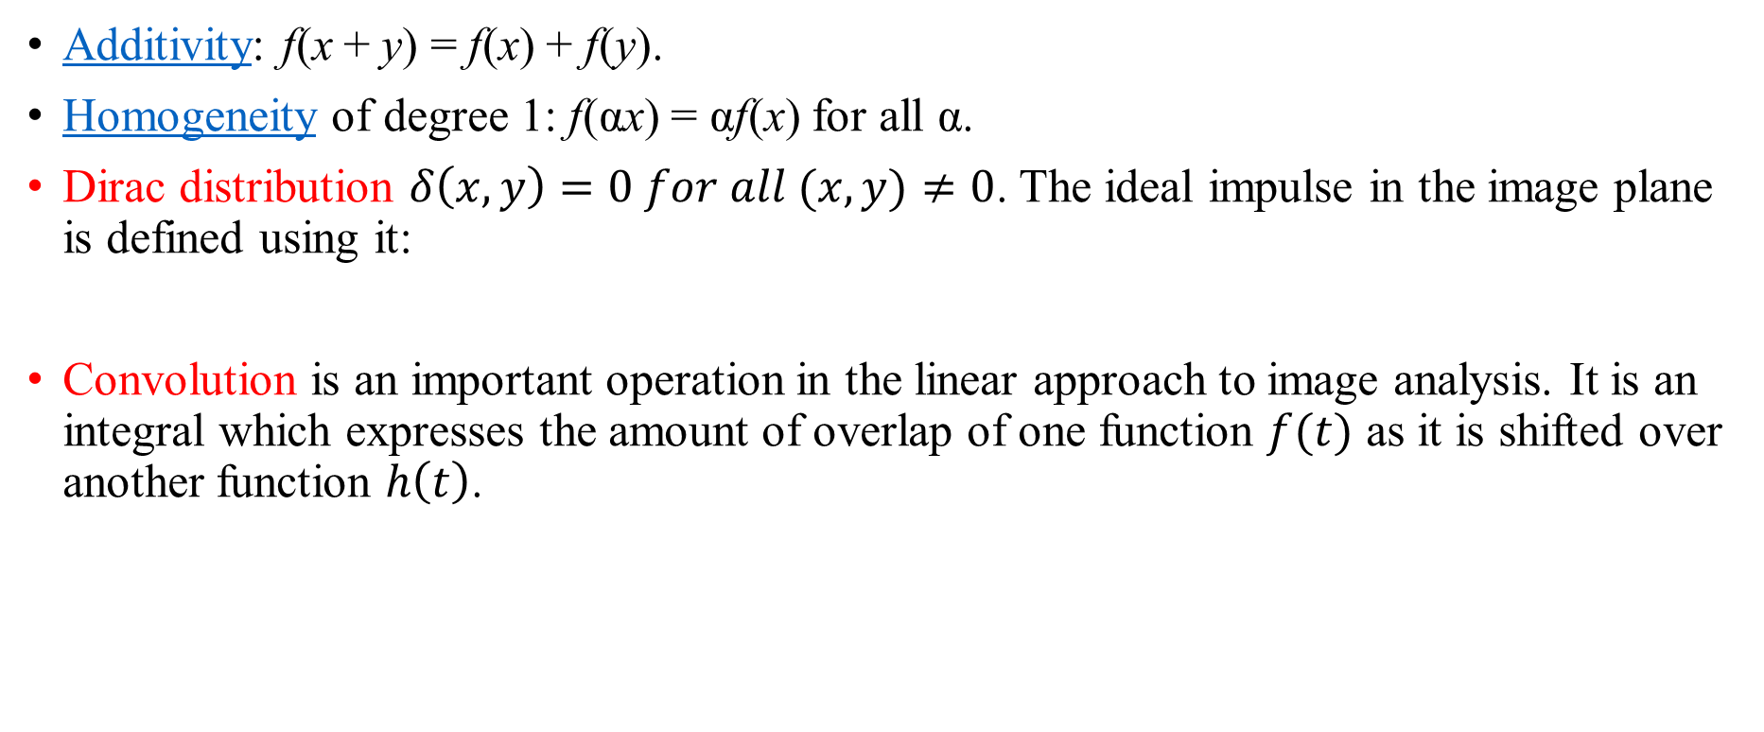
3.1 Linearity, Dirac distribution and convolution
Additivity: f(x + y) = f(x) + f(y).
Homogeneity of degree 1: f(αx) = αf(x) for all α.
Dirac distribution $δ\left(x,y\right)=0 for all (x,y)≠0$. The ideal impulse in the image plane is defined using it:
Convolution is an important operation in the linear approach to image analysis. It is an integral which expresses the amount of overlap of one function $f(t)$ as it is shifted over another function $h\left(t\right)$.

Slide 4
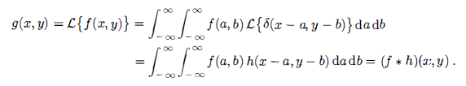
3.2 Linear integral transforms
Two domains: spatial domain (pixels) and frequency domain (frequency spectra)
An image can be expressed as a linear combination of point spread functions represented by Dirac pluses.

Slide 5
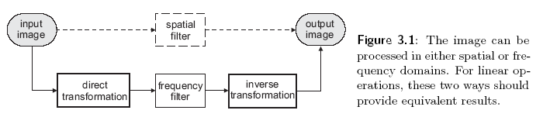
3.2 Introduction to linear integral transforms
Introduction to linear integral transforms provide a tool which permits representations of signals and images in a more suitable domain, where information is better visible and the solution of related problems is easier.
Common used linear integral transforms in image are the Fourier, cosine and wavelet transforms.

Slide 6


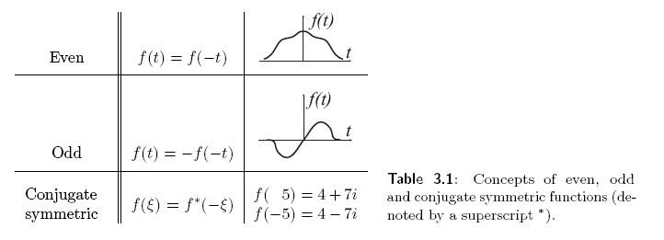
1D Fourier transform and its inverse one
Its predictable symmetries:

Slide 7
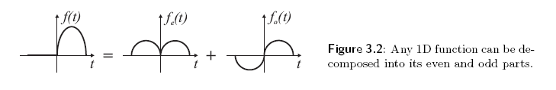
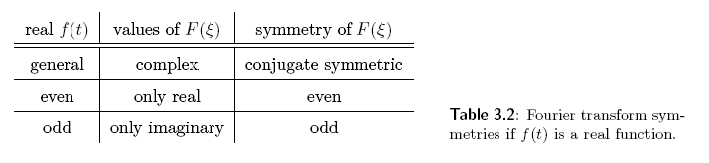
The ability to form a function from its even and odd parts

Slide 8
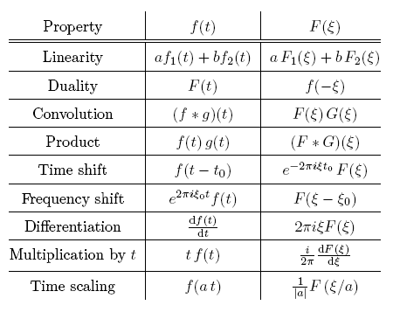
Properties of the Fourier transform

Slide 9
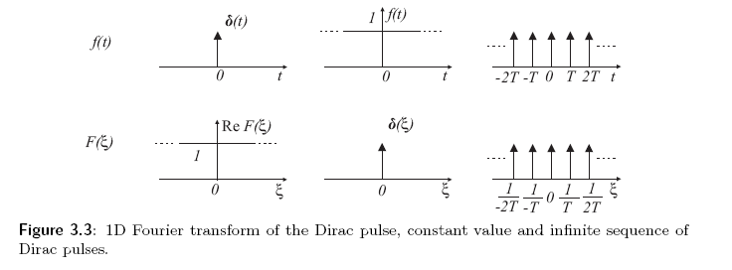
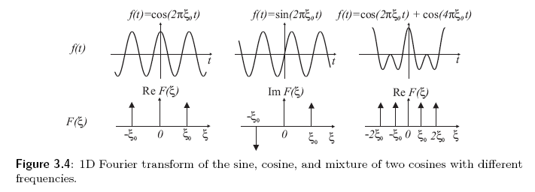

Slide 10
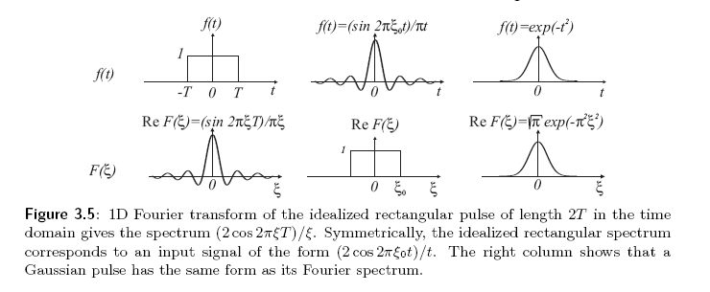

Slide 11





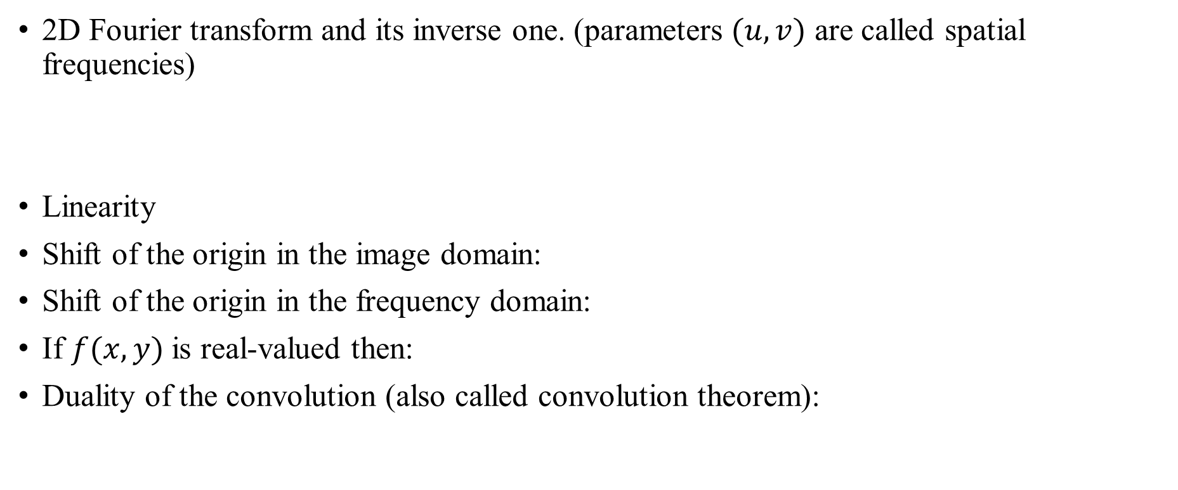
2D Fourier transform and its inverse one. (parameters $(u,v)$ are called spatial frequencies)
Linearity
Shift of the origin in the image domain:
Shift of the origin in the frequency domain:
If $f(x,y)$ is real-valued then:
Duality of the convolution (also called convolution theorem):

Slide 12

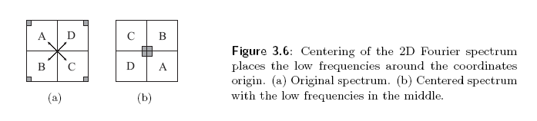
2D Fourier transform in discrete images

Slide 13
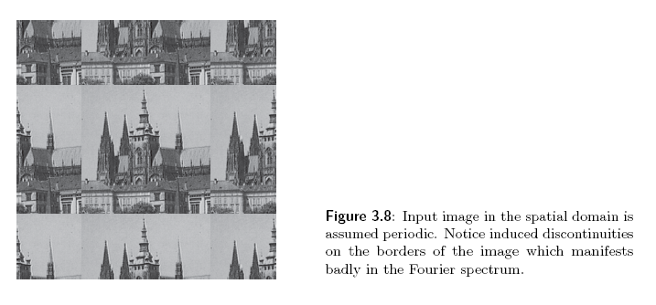
The spectrum is demonstrated in this picture, an image of the Saint Vitus Cathedral.
256*256 size in 256 gray levels.

Slide 14
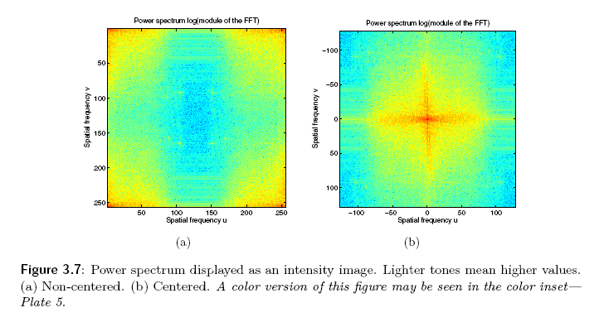
Power spectrum displayed as an intensity image

Slide 15
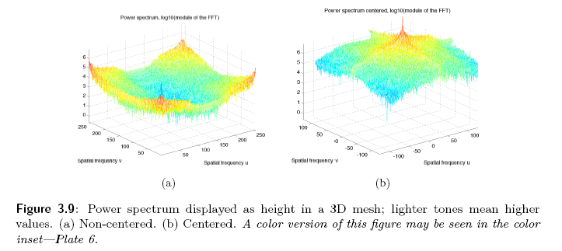
Power spectrum displayed as a 3D mesh

Slide 16


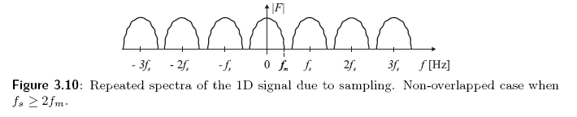

Sampling and the Shannon constraint
Sampling intervals $∆x,∆y$
Ideal sampling
The sampled image $f_{s}(x,y)$ is the product of the continuous image $f(x,y)$ and the sampling function $s(x,y)$
So, how about the sampling intervals?

Slide 17

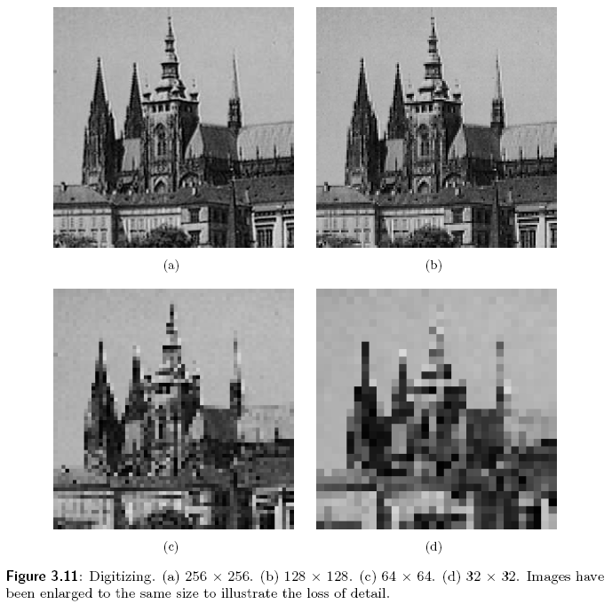
Aliasing: Periodic repetition of the Fourier transform result may under certain conditions cause distortion of the image.
Overlapping can be prevented if the sampling interval is chosen such that
Shannon sampling theorem

Slide 18
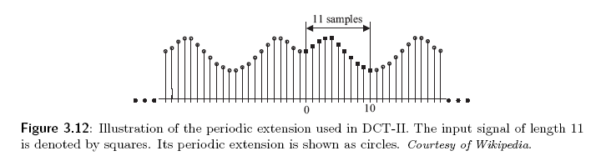
DCT
Discrete cosine transform (DCT)
In 1D, cosines with growing frequencies constitute the basis functions used for function expansion.

Slide 19

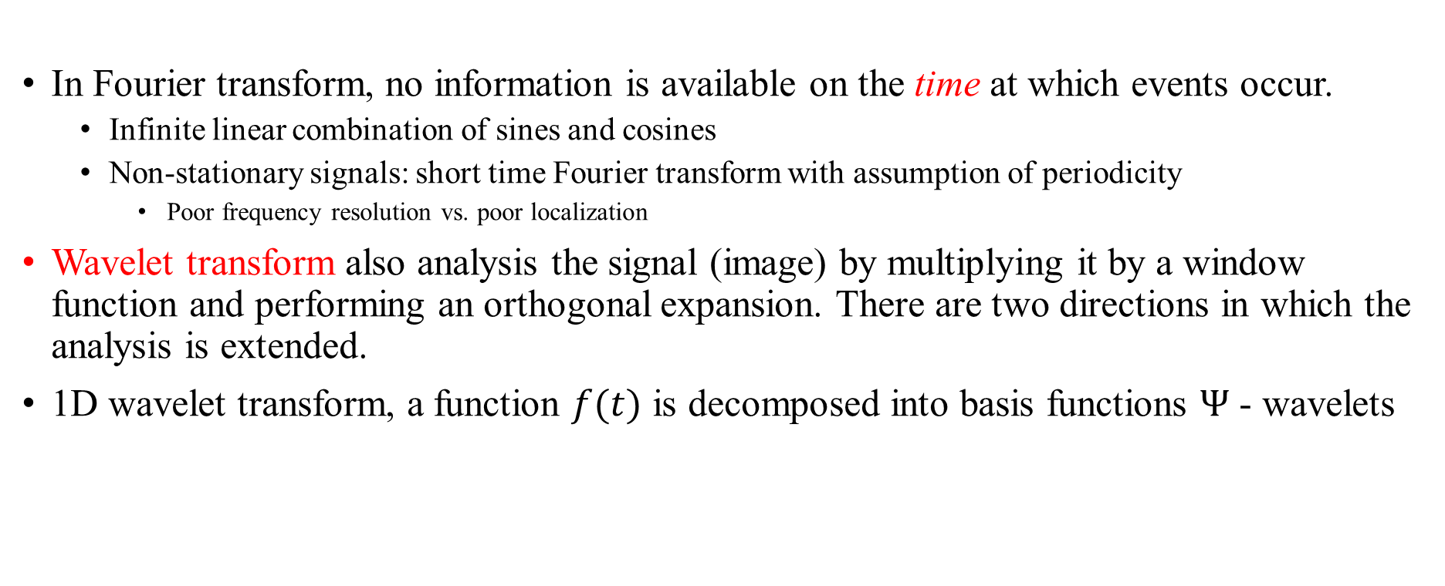
DWT
In Fourier transform, no information is available on the time at which events occur.
Infinite linear combination of sines and cosines
Non-stationary signals: short time Fourier transform with assumption of periodicity
Poor frequency resolution vs. poor localization
Wavelet transform also analysis the signal (image) by multiplying it by a window function and performing an orthogonal expansion. There are two directions in which the analysis is extended.
1D wavelet transform, a function $f(t)$ is decomposed into basis functions $Ψ$ - wavelets

Slide 20
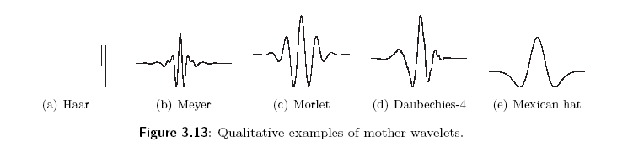



DWT
Wavelets are generated from the single mother wavelet $Ψ(t)$ by scaling s and translation $τ$
To form 1D signal $f(t)$ (wavelet coefficients $c(s, τ)$)

Slide 21
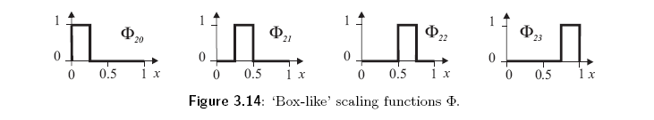
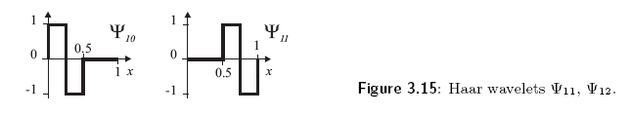
Scaling and shifting on the oldest and the most simple mother wavelet (Haar wavelets)

Slide 22
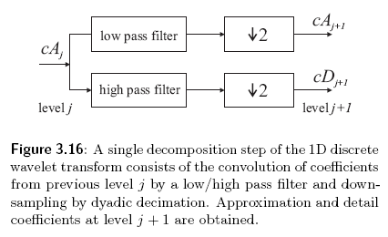
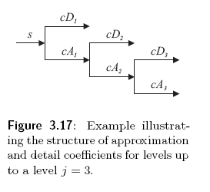

Fast wavelet transform can be imagined as a box into which a signal (an image) enters and the wavelet coefficients $c$ appear quickly at its output.

Slide 23
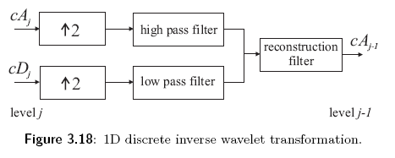
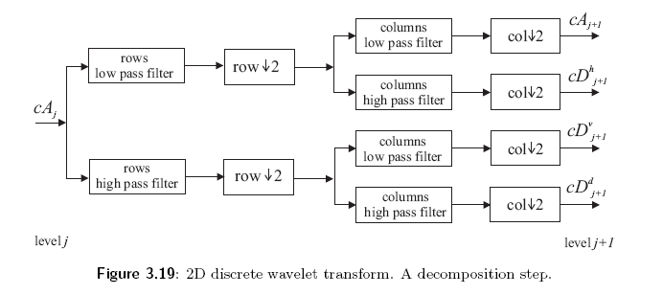

Slide 24
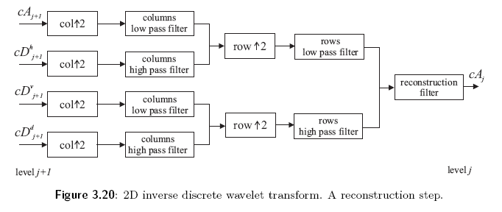

Slide 25
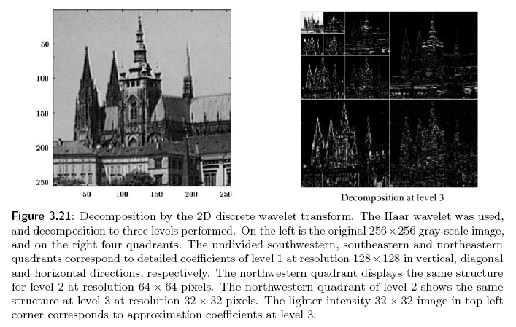

Slide 26
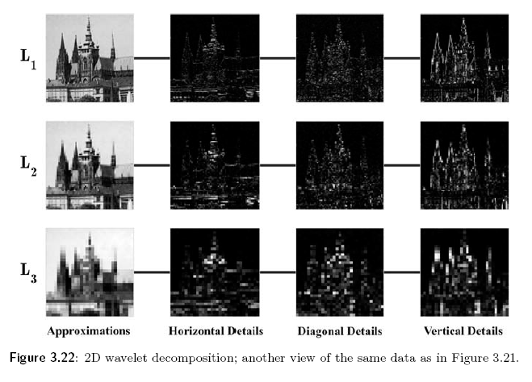

Slide 27
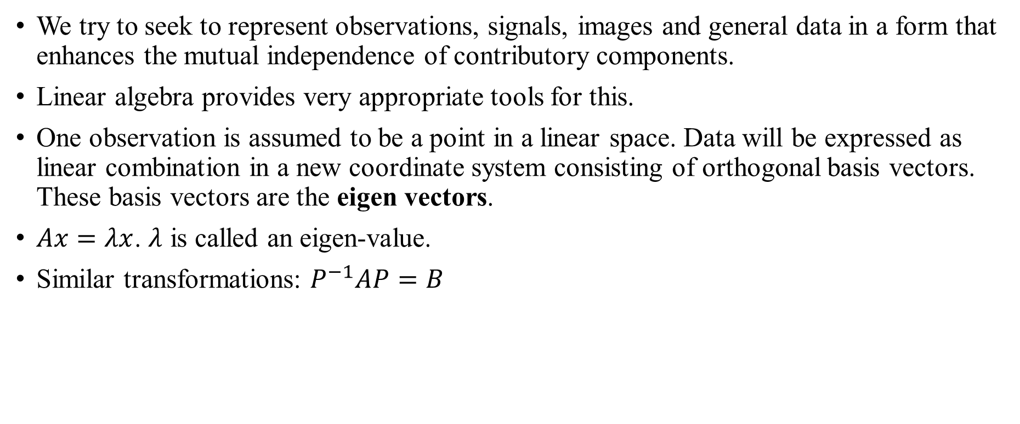
We try to seek to represent observations, signals, images and general data in a form that enhances the mutual independence of contributory components.
Linear algebra provides very appropriate tools for this.
One observation is assumed to be a point in a linear space. Data will be expressed as linear combination in a new coordinate system consisting of orthogonal basis vectors. These basis vectors are the eigen vectors.
$Ax=λx$. $λ$ is called an eigen-value.
Similar transformations: $P^{−1}AP=B$

Slide 28

Singular value decomposition (AVD) can be understood as decoupling input of size $m$ into output of size $n$
A non-negative real number $δ$ is a singular value of a matrix A if and only if there exist unit-length vectors $μ$ and $υ$ such that $Aυ=δμ$ and $A^{∗}μ=δυ$
SVD can be used to find a solution of a set of linear equations corresponding to a singular matrix that has no exact solution.

Slide 29
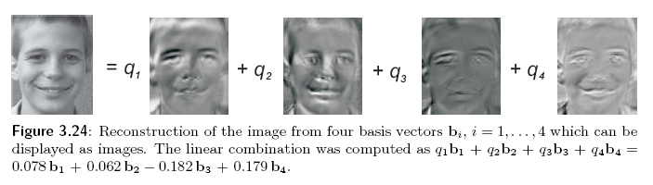
Principal component analysis (PCA), for simplifying a multidimensional dataset to lower dimensions for analysis or visualization.
PCA is a linear transform that represents the data in a new coordinate system in which basis vectors follow modes of greatest variance in the data.

Slide 30
Other orthogonal image transforms:
Hadamard-Haar
Slant and Slant-Haar
Discrete sine transform
Paley and Walsh
Radon Transform

Slide 31
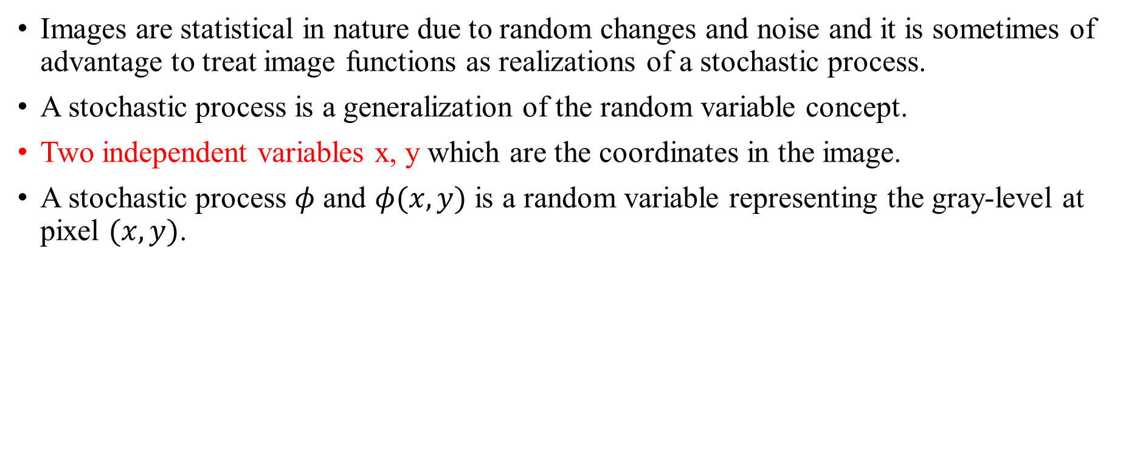
3.3 Image as stochastic processes
Images are statistical in nature due to random changes and noise and it is sometimes of advantage to treat image functions as realizations of a stochastic process.
A stochastic process is a generalization of the random variable concept.
Two independent variables x, y which are the coordinates in the image.
A stochastic process $φ$ and $φ(x,y)$ is a random variable representing the gray-level at pixel $(x,y)$.

Slide 32
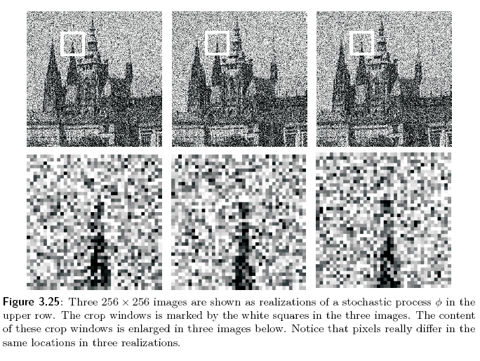
Three of many possible realizations of a stochastic process with Gaussian noise with zero mean and standard deviation 0.1 in the scale of [0, 1].

Slide 33

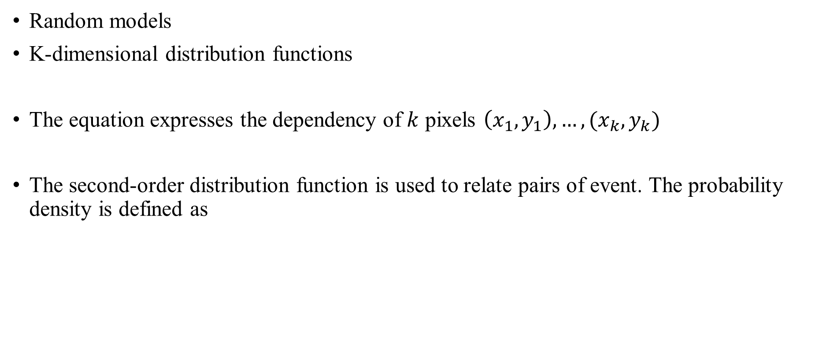
Random models
K-dimensional distribution functions
The equation expresses the dependency of $k$ pixels $\left(x_{1},y_{1}\right),…,(x_{k},y_{k})$
The second-order distribution function is used to relate pairs of event. The probability density is defined as

Slide 34


The autocorrelation and cross correlation functions are often used in searching for similarities in images or image parts.
Autocorrelation function:
Autocovariance function
A stationary process is a special stochastic process. Its properties are independent of absolute the position in the image plane. The autocorrelation function of a stationary process is translation invariant and depends only on the difference between co-ordinates.

Slide 35
3.4 Image formation physics
Three types of emitted energy can be used to image objects:
Electromagnetic radiation, like X-rays
Radiation of particles, like electrons or neutrons
Acoustic waves in gases, liquids and solids.
Two source of energy:
Because of thermal motion of molecules
Because of external stimulation, like reflected radiance.
Some information to identify observed objects:
Frequency of radiation expressed by wavelength
Amplitude, such as intensity of the radiation
Polarization mode for transverse waves.
Phase which is accessible only if coherent imaging techniques are used, like interferometry or holography

Slide 36
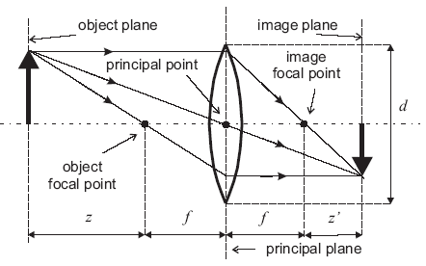

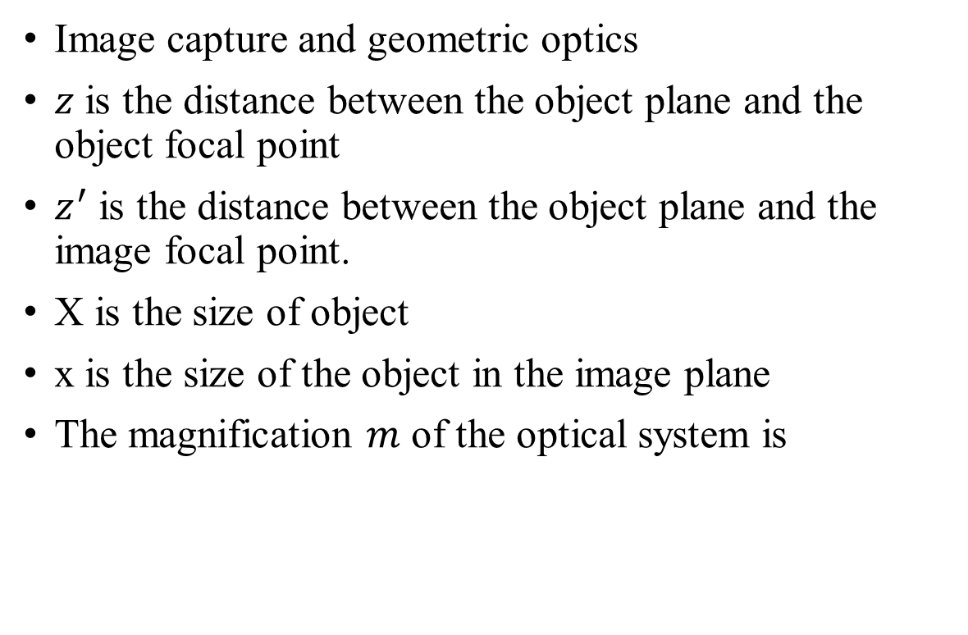
Image capture and geometric optics
$z$ is the distance between the object plane and the object focal point
$z^{′}$ is the distance between the object plane and the image focal point.
X is the size of object
x is the size of the object in the image plane
The magnification $m$ of the optical system is

Slide 37
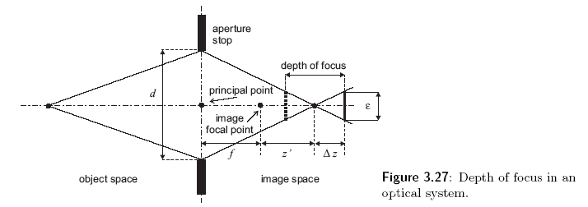

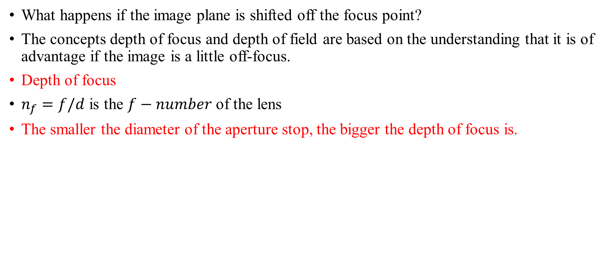
What happens if the image plane is shifted off the focus point?
The concepts depth of focus and depth of field are based on the understanding that it is of advantage if the image is a little off-focus.
Depth of focus
$n_{f}=f/d$ is the $f−number$ of the lens
The smaller the diameter of the aperture stop, the bigger the depth of focus is.

Slide 38
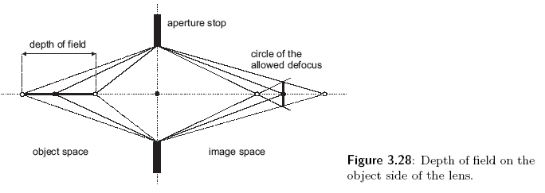

Depth of field, governs the permitted range of positions of observed objects in the scene which will be effectively in focus, i.e. with allowed defocus of maximal $ε$.
Real lens are composed of several individual lenses and their model in geometric optics is called a thick lens.

Slide 39
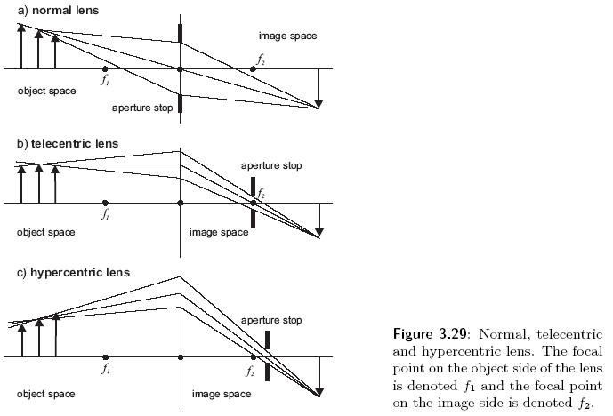
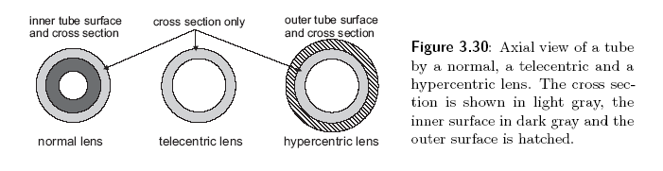
Telecentric lens, practically useful optical trick which makes gauging easier.

Slide 40
Lenses and other optical systems such as mirrors or prisms have defects which lead to blur, color changes, geometric distortion from the ideal ray. These errors are usually called aberrations in optics.
Spherical aberration, prevents rays from meeting at the same image point.
Coma is produced when rays from an off-axis object are images by different zones of the lens.
Astigmatism occurs when an optical system has different foci for rays that propagate in two perpendicular planes.
Curvatures of field refers to the locations of image points with respect to one another.
Chromatic aberration expresses the failure of a lens to focus all colors in the plane.

Slide 41
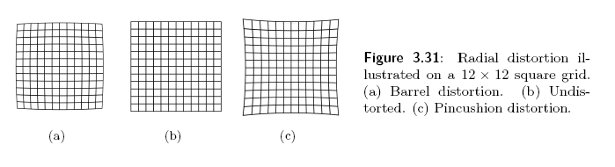
Radial distortion is caused since the lens bends a ray more or less than in the ideal case.
The shift of the principal point is with respect to the image midpoint.

Slide 42
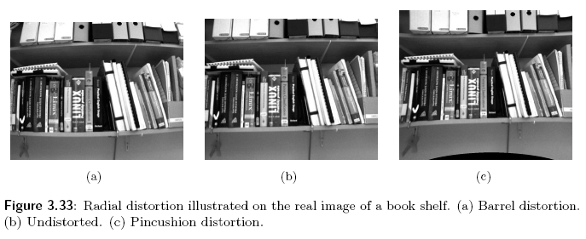
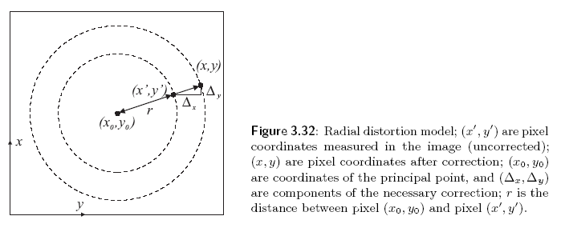

Slide 43
Image capture from a radiometric point of view.
A TV camera and most other artificial vision sensors measure, the amount of received light energy in individual pixels as the result of interaction among various materials and light source. The value measured is informally called a gray-level or brightness.
Radiometry, a branch of physics tat deals with the measurement of the flow and transfer of radiant energy.
Photometry, is a discipline closely related to radiometry that studies the sensation of radiant light energy in the human eye.
Irradiance describes the power of the light energy that falls onto a unit area of the object surface.

Slide 44
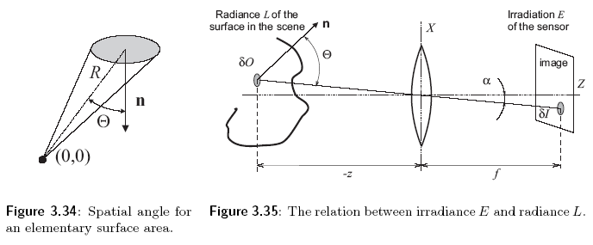

Slide 45





Surface reflectance and gradient space which is a way of describing surface orientations.
$z(x,y)$ is the surface height. Surface gradient
The surface normal and unit surface normal

Slide 46



The ability of the body to reflect light is described using a bi-directional reflectance distribution function (BRDF)
$dE$ is the irradiance of the elementary surface patch from the light source
$dL$ is the elementary contribution of the radiance in the direction towards the viewer.

